Slide 1
AC2DC STORAGE
LEADING THE CHARGE IN BATTERY STORAGE SOLUTIONS
Powering the Electriciﬁcation of Things™
The Race for Energy Independence has Begun
Solid State Battery Technologies and Energy Storage Systems
v2024.11.14_05

Slide 2
Our Mission
AC2DC STORAGE
LEADING THE CHARGE IN BATTERY STORAGE SOLUTIONS
We are the ﬁrst solid state energy storage system in the world. A game changer for power generation, renewable and environmental sectors. The Achilles’ heel of the power industry is energy storage. Energy storage systems are critical to the adoption and success of renewable energy technologies and must be deployed in the next ten years. We have the solution today to store all the world’s energy.
The future of our children and their children depends on us to decarbonize the planet as soon as possible.
For more information, contact us at (813) 212-7457 or email at support@AC2DCStorage.com www.AC2DCStorage.com
v2024.11.14_05

Slide 3
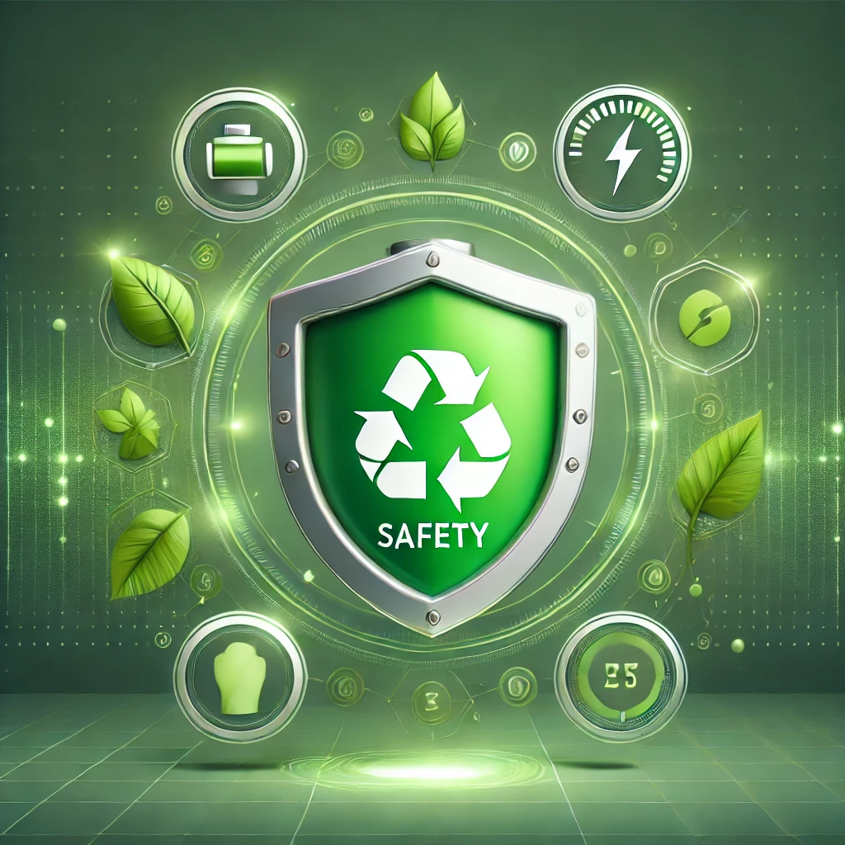
Why We Stand Out
AC2DC STORAGE
LEADING THE CHARGE IN BATTERY STORAGE SOLUTIONS
Superior Performance in All Conditions
Unmatched Safety & Reliability
Our Solid-State Battery Technology has been successfully implemented in high-stakes applications overseas for over four years, proving its reliability and durability in demanding environments.
Sustainable and Economical
v2024.11.14_05
For more information, contact us at (813) 212-7457 or email at support@AC2DCStorage.com www.AC2DCStorage.com

Slide 4
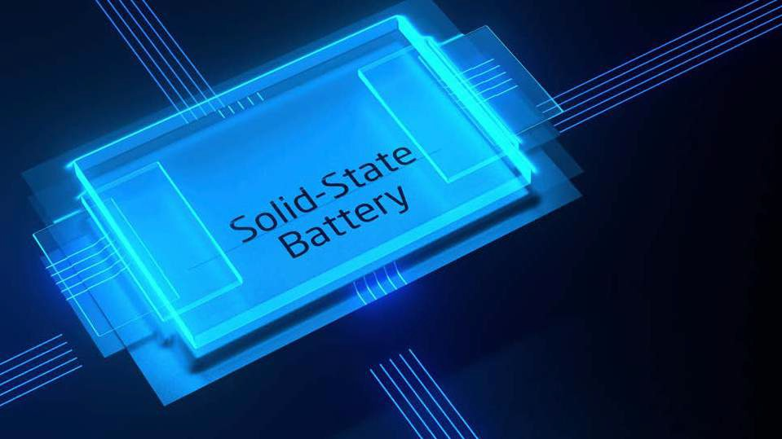
Solid State Battery Technology and Energy Storage Systems
Revolutionary and Innovative Technology
Safe: Non-explosive, Non-Toxic, and Non-Flammable Recyclable, Upcyclable, and Sustainable
Superior Technical Performance in Temperature and Output
Democratizing Energy Storage with Affordable Long-Term Solution
Veriﬁed Technical Performance
For more information, contact us at (813) 212-7457 or email at support@AC2DCStorage.com www.AC2DCStorage.com
v2024.11.14_05

Slide 5
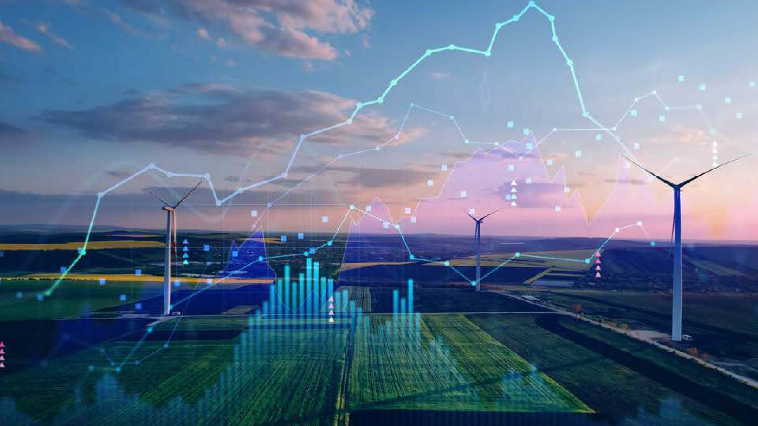
Product Overview
The Product
Solid State Technology
Tried and tested disruptive solid-state batteries through an exclusive, worldwide agreement.
A solid state battery uses solid electrodes & solid state electrolyte monomer with ceramic partition, yielding proven results.
Seizing the Market Opportunity
With the global concern over energy security and eﬃciency at an all-time high, we have the opportunity to lead the market in energy storage because of its revolutionary solid state technology.
Management Team
Shipping Solid State Systems NOW!
The management team has extensive expertise in technology, energy, manufacturing, product, marketing, distribution, renewable infrastructure projects and international markets.
We are shipping residential, commercial and utility energy storage systems in Q4, 2024 and beyond.
Production capacity for 2024- 2027:
Up to 4 GWh.
For more information, contact us at (813) 212-7457 or email at support@AC2DCStorage.com www.AC2DCStorage.com
v2024.11.14_05

Slide 6
Solid State Technology Competitive Advantage
Highest Full Charge Cycles in the World
Our 3rd generation solid state stationary ESS technology provides 11,000 cycles of full charges and an unlimited amount of shallow charges.
Largest Solid State Cell Capacities in the World
Large solid state cell capacities available in the following conﬁgurations: 500Ah, 750Ah,1000Ah, 1500Ah, 2500Ah, and 3000Ah.
Recyclable
Batteries are 100% recyclable, upcyclable, and sustainable.
Safety
Non-ﬂammable, non-toxic, and non-explosive. The temperature ranges between -40 (-40°F) and 70 (158°F).
Battery Management System (BMS)
Our battery can be controlled at the cell level while the competition can control only at the system level. The battery can be controlled either in parallel or series conﬁguration. The ability to manage at the cell level increases safety, optimization and eﬃciency.
Highest Full Charge Cycles in the World
The battery operates at much wider temperature ranges than the competition with excellent performance at low and high temperatures.
High Full Charge Cycles
Our energy storage solutions do not require cooling systems. There is no thermal runoff, extending the life of the battery and reducing total operational costs. The core does not heat, increasing safety. The core is in the solid structure resulting in no leakage combustion.
Lower Total Cost of Ownership
Our solid state battery’s cycle life is guaranteed for 25 years, the design life is 30 to 35 years and the annual charge retention rate is more than 96%, far exceeding the world’s current capability.
For more information, contact us at (813) 212-7457 or email at support@AC2DCStorage.com www.AC2DCStorage.com
6
v2024.11.14_05

Slide 7
Core Technologies
Amptricity Battery Classiﬁcation
Speciﬁc Energy | 210-280 Wh/kg and above (mobile energy: EV) 150-190 Wh/kg and above (storage energy @1500 Ah per core / 2000Ah per core) 377.55 Wh/kg and above (special purpose energy battery)
Internal Resistance No more than 0.2 milliohms | No more than 0.2 milliohms
Discharge Life Cycle (Unlimited Times of Shallow Charging / Discharging) | Mobile Energy >3000 times deep charging and discharging Storage Energy >11000 times deep charging and discharging
Fast Charge Time (with Amptricity Charging Station) | Less than 10 minutes
Self-Discharge Rate (yearly) Energy Retention Rate (yearly) | Less than 4% 96% and above
Cell Voltage | 3.7v
Charge Cutoff | NMC 4.2v LFP 3.6v
Discharge Cutoff | NMC 3v LFP 2.8v
Charge TemperaturesDischarge Temperatures | -20º to 60º C -40º to 60º C
Safety and Maintenance | No thermal runaway (natural heat dissipation) / thermally stable No external cooling or A/C system required
Mass Production | Since 2017
Toxicity | None
Annual Production Capacity | 2 Gigawatts
Solid-State Polymer Energy & Battery
For more information, contact us at (813) 212-7457 or email at support@AC2DCStorage.com www.AC2DCStorage.com
v2024.11.14_05

Slide 8
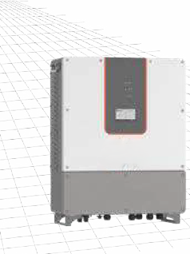
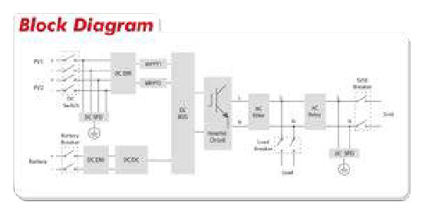
Inverter Speciﬁcations: Residential
HP55000TLS • HPS7500TLS • HPS10000TLS
 | ATESS HPS5000TLS | ATESS HPS7500TLS | ATESS HPS10000TLS
DC (Battery and PV)
Max PV Open-circuit voltage | 600V | 900V | 900V
Recommended PV power | 6kWp | 9kWp | 12kWp
PV MPPT voltage range | 125V-550V | 370V-720V | 370V-720V
Number of MPPT | 2 | 2 | 2
Recommended rated battery voltage | 300V | 350V | 450V
Battery voltage range | 85-500V | 280-700V | 280-700V
Full load battery voltage range | 250-500V | 300-700V | 400-700V
Max. charge/discharge power | 5kW | 7.5kW | 10kW
Max. charge/discharge current | 25A | 25A | 25A
General Information
Protection devices | PV DC switch ,battery breaker and fuse, PV fuse, grid breaker, load breaker
Protection degree | IP65 | IP65 | IP65
Noise emission | <65dB(A)@1m | <65dB(A)@1m | <65dB(A)@1m
Operating temperature | -25°C~+55°C | -25°C~+55°C | -25°C~+55°C
Cooling | Forced-air | Forced-air | Forced-air
Relative humidity | 0-95% non-condensing | 0-95% non- condensing | 0-95% non- condensing
Maximum altitude | 6000m (derate over 3000m) | 6000m (derate over 3000m) | 6000m (derate over 3000m)
Dimension (W/H/D) | 600/700/250mm | 600/700/250mm | 600/700/250mm
Weight | 50kg | 50kg | 50kg
Topology | Transformerless | Transformerless | Transformerless
Lighting protection | Type II | Type II | Type II
Transfer between on/off grid | Automatic≤20ms | Automatic≤20ms | Automatic≤20ms
Standby consumption Communication | <20W | <20W | <20W
Display | Touchscreen | Touchscreen | Touchscreen
Communication | RS485/CAN | RS485/CAN | RS485/CAN
 | HPS5000TLS | HPS7500TLS | HPS10000TLS
AC (Grid-connected)
Apparent power | 6.25kVA | 9.4kVA | 12.5kVA
Rated power | 5kW | 7.5kW | 10kW
Rated voltage | 230V | 230V | 230V
Rated current | 21.5A | 32.6A | 43.4A
Voltage range | 210V - 250V | 210V - 250V | 210V - 250V
Rated frequency | 50/60Hz | 50/60Hz | 50/60Hz
Frequency range | 47~51.5/57~61.5Hz | 47~51.5/57~61.5Hz | 47~51.5/57~61.5Hz
THDI | <3% | <3% | <3%
PF | 0.8lagging~08leading | 0.8lagging~08leading | 0.8lagging~08leading
AC connection | L/N/PE | L/N/PE | L/N/PE
AC (Off-grid)
Apparent power | 6.25kVA | 9.4kVA | 12.5kVA
Rated power | 5kW | 7.4kW | 10kW
Rated Voltage | 230V | 230V | 230V
Rated current | 21.5A | 32.6A | 43.4A
THDU | ≤2%linear | ≤2%linear | ≤2%linear
Rated frequency | 50/60Hz | 50/60Hz | 50/60Hz
Overload capability | 110%-10 mins 120%-1 min | 110%-10 mins 120%-1 min | 110%-10 mins 120%-1 min
For more information, contact us at (813) 212-7457 or email at support@AC2DCStorage.com www.AC2DCStorage.com
v2024.11.14_05

Slide 9
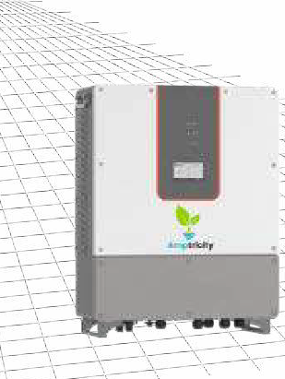
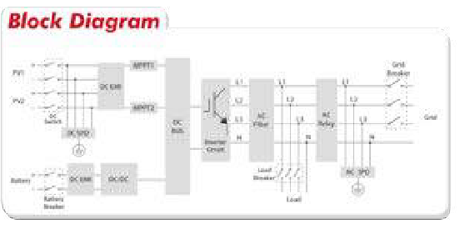
Inverter Speciﬁcations: Residential
HPS7500TL • HPS10000TL
 | HPS7500TL |  | HPS10000TL
DC (Battery and PV)
Max PV Open-circuit voltage | 900V |  | 900V
Recommended PV power | 9kWp |  | 12kWp
PV MPPT voltage range | 370V-720V |  | 370V-720V
Number of MPPT | 2 |  | 2
Recommended rated battery voltage | 350V |  | 450V
Battery voltage range | 280-700V |  | 280-700V
Full load battery voltage range | 300-700V |  | 400-700V
Max. charge/discharge power | 7.5kW |  | 10kW
Max. charge/discharge current | 25A |  | 25A
General Information
Protection devices | PV DC switch, battery breaker and fuse, PV fuse, grid breaker, load breaker
Protection degree | IP65 |  | IP65
Noise emission | <65dB(A)@1m |  | <65dB(A)@1m
Operating temperature | -25°C~+55°C |  | -25°C~+55°C
Cooling | Forced-air |  | Forced-air
Relative humidity | 0-95% non-condensing |  | 0-95% non-condensing
Maximum altitude | 6000m (derate over 3000m) |  | 6000m (derate over 3000m)
Dimension (W/H/D) | 600/700/250mm |  | 600/700/250mm
Weight | 50kg |  | 50kg
Topology | Transformerless |  | Transformerless
Lighting protection | Type II |  | Type II
Transfer between on/off grid | Automatic≤20ms |  | Automatic≤20ms
Standby consumption Communication | <20W |  | <20W
Display | Touchscreen | Touchscreen | Touchscreen
Communication | RS485/CAN | RS485/CAN | RS485/CAN
AC (Grid-connected)
HPS7500TL
HPS10000TL
Apparent power
9.4kVA
12.5kVA
Rated power
7.5kW
10kW
Rated voltage
400V
400V
Rated current
10.8A
14.4A
Voltage range
360V - 440V
360V - 440V
Rated frequency
50/60Hz
50/60Hz
Frequency range
47~51.5/57~61.5Hz
47~51.5/57~61.5Hz
THDI
<3%
<3%
PF
0.8lagging~08leading
0.8lagging~08leading
AC connection
AC (Off-grid)
3/N/PE
3/N/PE
Apparent power
9.4kVA
12.5kVA
Rated power
7.4kW
10kW
Rated Voltage
400V
400V
Rated current
10.8A
14.4A
THDU
≤2%linear
≤2%linear
Rated frequency
50/60Hz
50/60Hz
Overload capability
110%-10 mins 120%-1 min
110%-10 mins 120%-1 min
For more information, contact us at (813) 212-7457 or email at support@AC2DCStorage.com www.AC2DCStorage.com
v2024.11.14_05

Slide 10
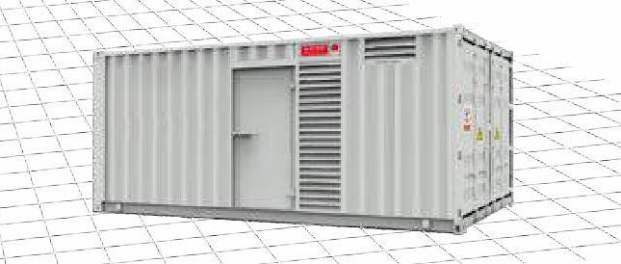
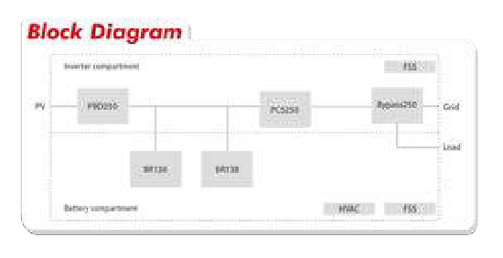
Inverter Speciﬁcations: Commercial
PCS250 Station
DC (Battery)
Cell type | 3.2V/100Ah
Conﬁguration of battery module | 12S2P
Conﬁguration of battery bank | 18S2P
Battery capacity | 276kWh
Rated voltage | 691.2V
Battery voltage range | 605.8V-766.8V
Rated current | 417A
Rated charge/discharge | 0.5C
Max. charge/discharge current | 1C
Communication | CAN
DC(PV)
Max. PV open circuit voltage | 1000VDC
Recommended PV power | 250kWp
MPPT voltage range | 350V-850V
Full load MPPT voltage range | 480V-850V
Max. input current | 575A(115A*5)
Number of MPPT | 5
General information
Conﬁguration | PCS250+PBD250+Bypass250+BR138*2
Dimension(W/H/D) | 6058/2591/2438mm
Weight | 10000kg
Operating temperature | -25°C~+55°C
Relative humidity | 0-95% non-condensing
Protection degree | IP54
Maximum altitude | 6000m(derate over 3000m)
Standby consumption | <100W
Lighting system | LED lighting
Fire ﬁghting system | Industrial grade
Cooling of battery chamber | HVAC
Cooling of PCS chamber | Forced aid
Transfer between on/off grid | Automatic≤10ms
 | PCS250 Station
AC (Grid-connected)
Apparent power | 275kVA
Rated power | 250kW
Rated voltage | 400V
Rated current | 361A
Voltage range | 310V - 450V
Rated frequency | 50/60Hz
Frequency range | 45-55/55-65Hz
Isolation method | Transformer
Overload capability | 110%-10min 120%-1 min
AC connection | 3/N/PE
For more information, contact us at (813) 212-7457 or email at support@AC2DCStorage.com www.AC2DCStorage.com
v2024.11.14_05

Slide 11
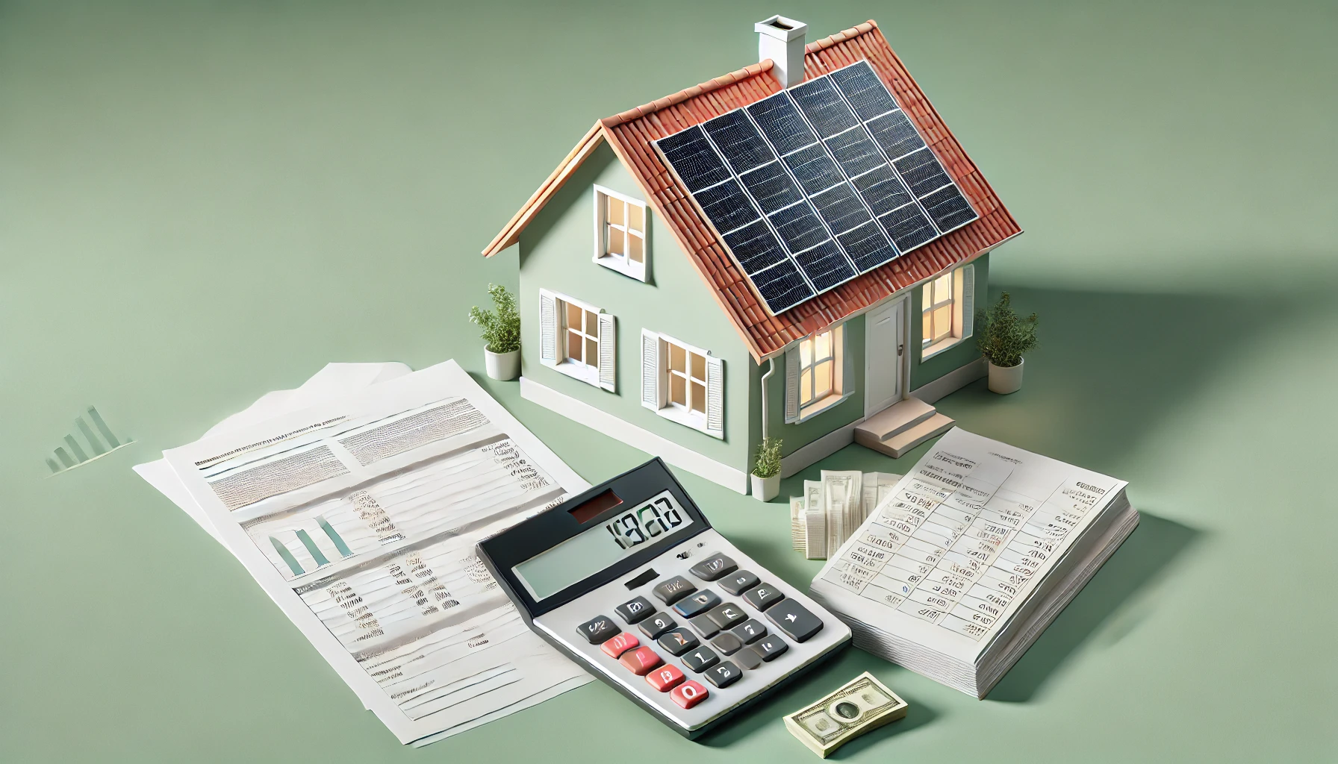
Strategic Financing Partner
$5 Billion in Residential Financing
We have formed a strategic alliances with a wholly owned subsidiaries of the top 10 U.S. Banks to finance residential communities/ commercial product line up to $10 Billion in consumer financing (U.S. Market).
LEASING OPTIONS COMING SOON.
For more information, contact us at (813) 212-7457 or email at support@AC2DCStorage.com www.AC2DCStorage.com
v2024.11.14_05

Slide 12
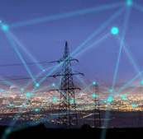
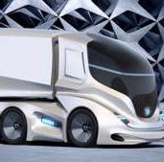
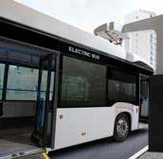
Primary Market Focus: Energy Storage Solutions
Primary Market Focus: Energy Storage Solutions
Solar Utilities
Wind
Commercial Industrial Government
EV Charging Stations
Electric Trucks
Electric Buses
Secondary Market Focus: Mobile Energy Storage
For more information, contact us at (813) 212-7457 or email at support@AC2DCStorage.com www.AC2DCStorage.com
v2024.11.14_05

Slide 13
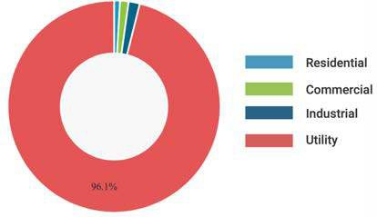
Global Energy Market
Global Advanced Energy Storage Market ($USD) 2018 to 2026
Global Advanced Energy Storage Market Value Share by Application 2018
250
$144.95 $211.20
Billion Billion
200
150
100
50
0
2018 2020
Source: Fortune Business Insights
2022
2024
2026
For more information, contact us at (813) 212-7457 or email at support@AC2DCStorage.com www.AC2DCStorage.com
v2024.11.14_05

Slide 14
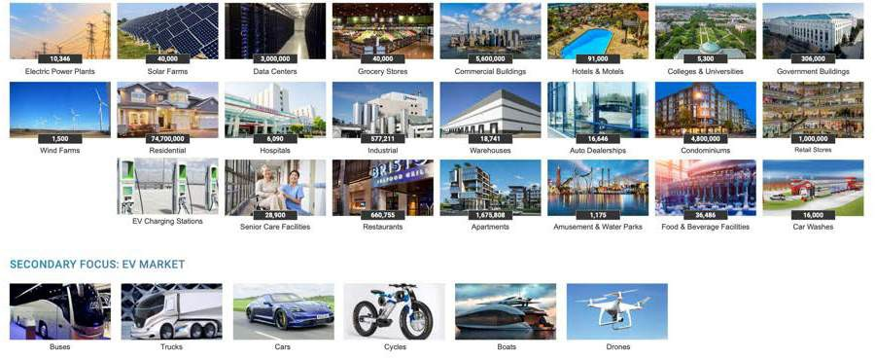
Addressable Markets
PRIMARY FOCUS: STATIONARY ENERGY STORAGE SOLUTIONS
For more information, contact us at (813) 212-7457 or email at support@AC2DCStorage.com www.AC2DCStorage.com
v2024.11.14_05

Slide 15
Market Applications
STATIONARY APPLICATIONS
12 kWh
60 kWh
150 kWh
1 MWh
60 kWh
120 kWh
180 kWh
1 MWh
1.5 MWh
2 MWh
3 MWh
4 MWh
12 kWh
24 kWh
36 kWh
48 kWh
60 kWh
150 kWh
310 kWh
470 kWh
For more information, contact us at (813) 212-7457 or email at support@AC2DCStorage.com www.AC2DCStorage.com
v2024.11.14_05

Slide 16
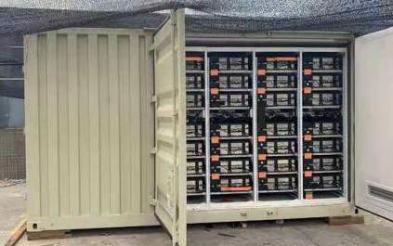
Application: Energy Storage Solution at Hotel
Building and Emergency Energy Storage
The system was put into operation at the Crowne Plaza Hotel in January 2018— implementing demand-side management, peak cutting, and valley ﬁlling, emergency reserve, and load eﬃciency improvement.
The 1MW energy storage module only contains 196 single cores in series.
Conﬁguration method: the system is equipped with a grouping type, which can be expanded by multiples. The supporting PCS (Power Conversion System) can realize an unlimited grid connection on the interchange side.
Description
Parameters
Notes
The Capacity of the Energy Storage System
1 MWh
Annual Charge Retention >96%
Rated Charging Powerpacity
250KW
Rated Discharge Power
250 kW
Infinite Parallel Connection of AC Measurement
Rated Output Voltage
AC380
Rated Output Frequency
323V~418V
Rated Output Frequency
50Hz
Frequency Range
48-51 Hz
Working Temperaturee Life
-40oC-60oC
Output Wiring Mode
DC Side, Cable, or Bus
External communications mode
Ethernet RS485
Overall Size of Battery Cabinet
7.8 ft. x 4.24 ft. x 6.9 ft.
47.36 square feet
Thermal Management System
Natural heat dissipation
Container Ports:
Power Port
Distribution Port
Communication
Grounding Port
1 Way Direct
1 Way Direct
1 Way Direct
1 Way on the Spot
Application Area: It is applied to large-scale industrial energy storage power station, mobile power station, large-scale communication power supply, cloud computing power supply, high speed rail system energy, and other fields.
For more information, contact us at (813) 212-7457 or email at support@AC2DCStorage.com www.AC2DCStorage.com
v2024.11.14_05

Slide 17
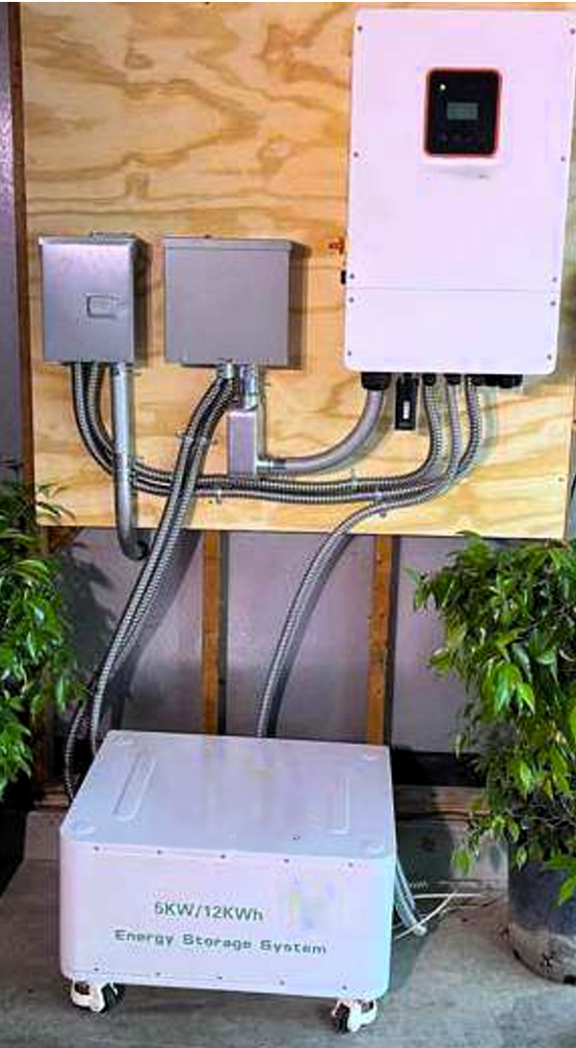
Case Study: Austin Residential
First12 kW Installation
Always On Power
Energy Independence
In March of 2024, the ﬁrst Solid State Battery was installed in combination with a solar application on a residential home in Austin, Texas.
After consecutive years of severe winter-weather-related power outages, the homeowner wanted to ensure power-continuity year round.
A 12 kWh system with an 8 hour discharge time allowed the homeowner to be virtually energy independent. Solar panels power the home and charge the battery during the day, and the battery discharges overnight. In the event of a power outage, the batter can simultaneously charge and discharge.
This enables the combination of solar and the Solid State Battery System to operate 24/7/365 without relying on the Austin power grid.
v2024.11.13_04
For more information, contact us at (813) 212-7457 or email at support@AC2DCStorage.com www.AC2DCStorage.com

Slide 18
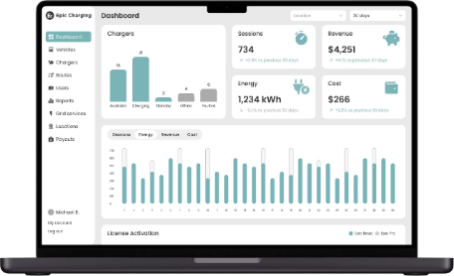
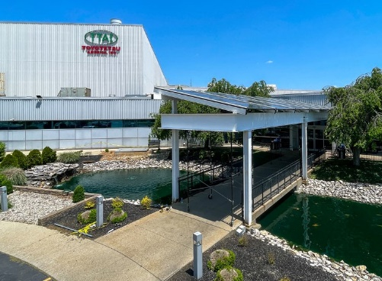
AC2DC STORAGE
LEADING THE CHARGE IN BATTERY STORAGE SOLUTIONS
Some of our other Partners
As an alternative energy solutions provider, AC2DC STORAGE collaborates with companies that champion sustainable energy initiatives.
EV Charging Software
Epic Charging believes the future of electric transportation depends on open, hardware-agnostic systems. Their mission is to collaborate with software and hardware providers, ensuring flexibility and top-tier customer satisfaction. Founded to bridge technical and service gaps in EV charging, they are recognized for rapid development, simplified solutions, and a commitment to outstanding service, shaping a future where electric transportation is accessible, seamless, and personalized.
Solar Canopies
Innervations designs durable, innovative solar canopies for homes and businesses. These canopies fit into any space, providing clean energy, lowering utility costs, increasing property value, and supporting sustainability by reducing carbon emissions. They also offer shade, weather protection, and turn unused areas into renewable energy sources.
For more information, contact us at (813) 212-7457 or email at support@AC2DCStorage.com www.AC2DCStorage.com
v2024.11.14_05

Slide 19
"Rain or shine, we've got your power needs covered—because energy never takes a day off!"
"Join Us in Leading the Energy Revolution! With AC2DC Storage's groundbreaking solid-state battery technology, energy independence is within reach. Take the first step toward a sustainable, reliable power solution. Contact us to discuss how we can meet your energy needs and be a part of your journey to a greener future. Call us at (813) 212-7457 or visit www.AC2DCStorage.com."
CLICK HERE TO TAKE THE NEXT STEP
v2024.11.14_05

